Slide 1
Brain and Behavior
Chapter 2

Slide 2
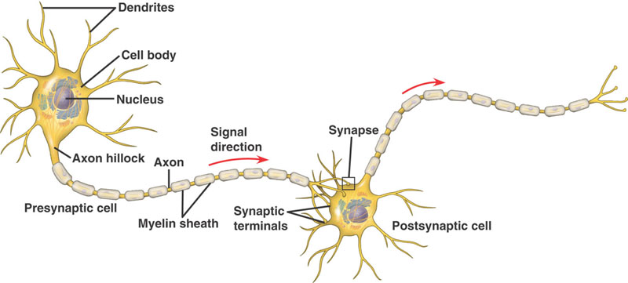
Brain and Behavior
Neurons

Slide 3
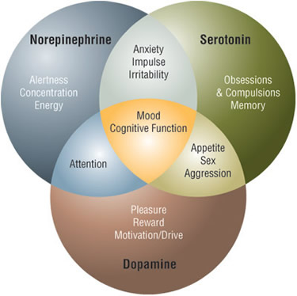
Brain and Behavior
Neuro-transmitters
  Table 2.1, page 55

Slide 4
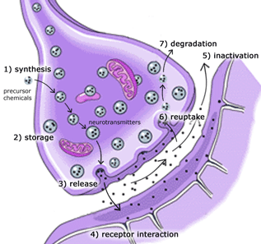
Brain and Behavior
Neurotransmission
    http://depression.emedtv.com/depression-video/the-brain-and-its-chemicals-video.html

Slide 5
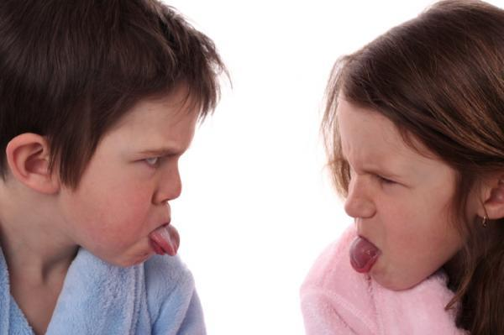
Brain and Behavior
Mirror neurons (page 68)
  http://www.pbs.org/wgbh/nova/sciencenow/3204/01.html
Motor movement
Emotions
Empathy
Autism
Language
Culture

